Slide 1

SPHERE: SAN JOAQUIN VALLEY POLLUTION AND HEALTH ENVIRONMENTAL RESEARCH
Ada Chibueze
Mentor: Rosemary Castorina
August 11, 2023
STEER SYMPOSIUM

Slide 2


Research Process
LITERATURE REVIEW
QUALITY CHECKS
START
END
DATA CLEANING
DATA ANALYSIS

Slide 3
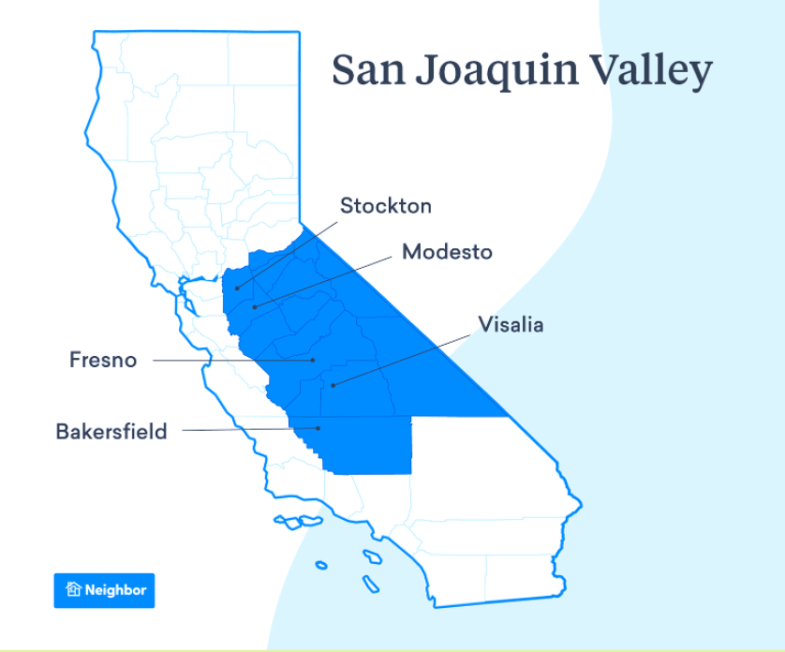

Slide 4
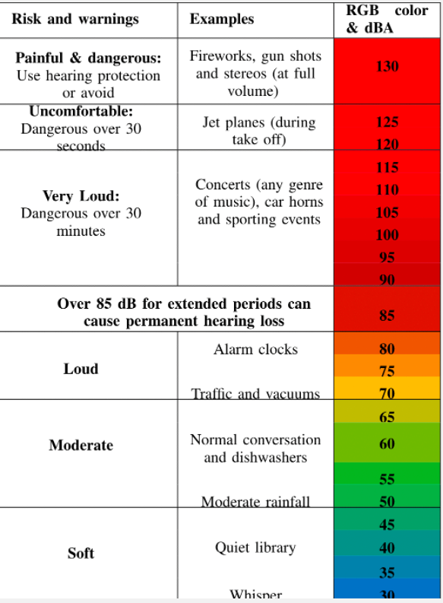

"The traditional definition of noise is unwanted or disturbing sound. Sound becomes unwanted when it either interferes with normal activities such as sleeping, conversation, or disrupts or diminishes one’s quality of life."
- Environmental Protection Agency

Slide 5




Soundscape of the San Joaquin Valley
TRANSPORTATION
INDUSTRIAL OPERATIONS
NEIGHBORHOOD NOISE
CONSTRUCTION
Cars, trucks, buses, motorcycles, trains, and airplanes
Machinery, equipment, fans, and industrial processes
Lawnmowers, leaf blowers, parties, barking dogs
Jackhammers, generators, pavers
MAJOR SOURCES OF NOISE POLLUTION INCLUDE TRANSPORTATION VEHICLES, INDUSTRIAL MACHINERY, AND SOUNDS FROM RESIDENTIAL NEIGHBORHOODS.

Slide 6
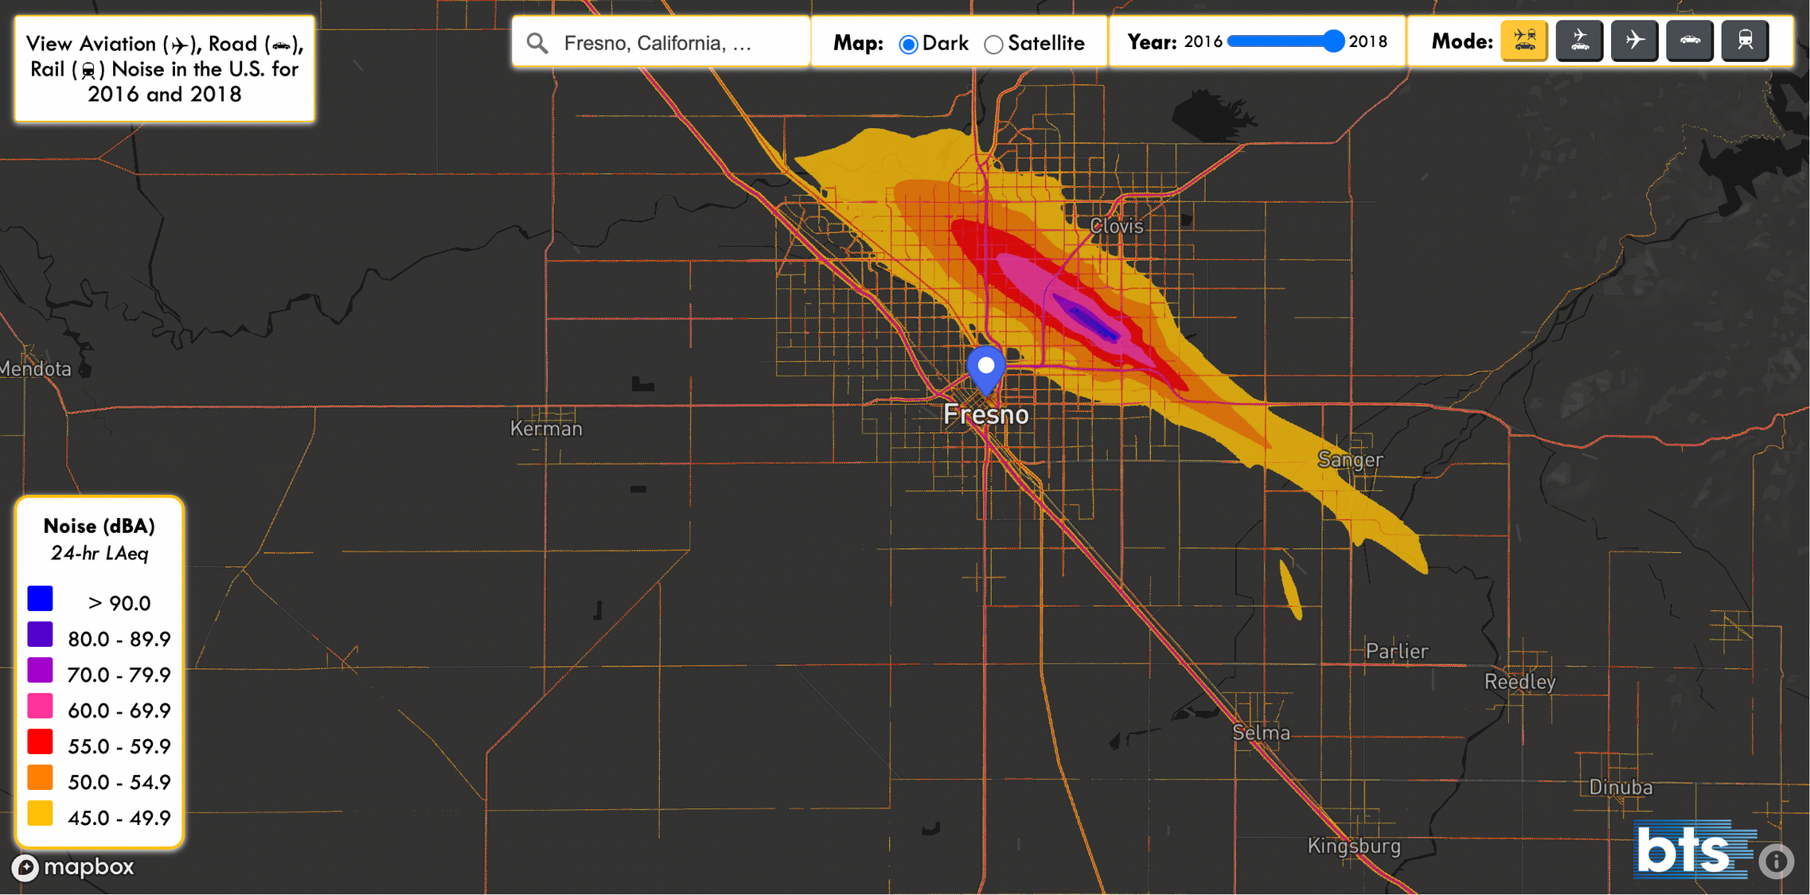

Slide 7
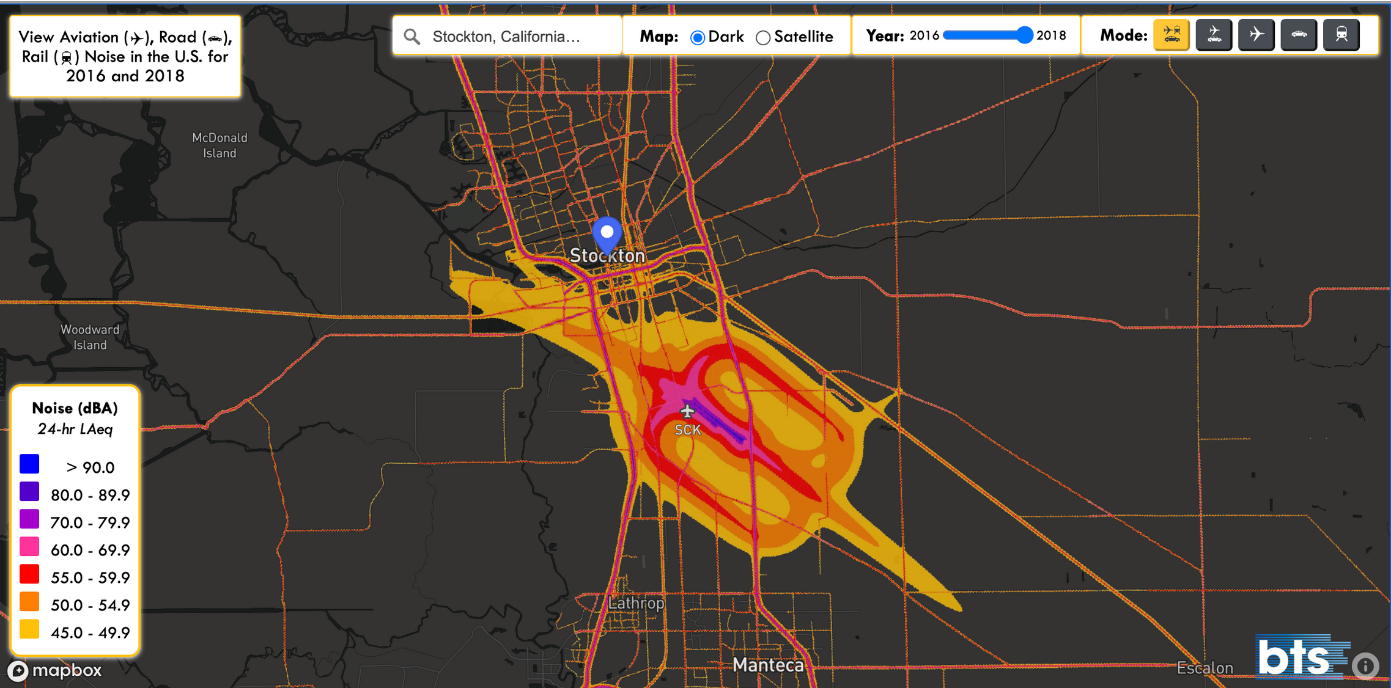

Slide 8
Health Implications of Noise Exposure
SLEEP DISTURBANCE
HEARING LOSS
CARDIOVASCULAR DISEASE
Noise pollution disrupts sleep patterns and decreases sleep time.
Long-term noise exposure damages sensitive structures in the inner ear, causing permanent hearing loss.
Noise pollution increases stress hormones and blood pressure, raising risk of hypertension, stroke, and heart attacks.
COGNITIVE IMPAIRMENT
MENTAL HEALTH ISSUES
Noise makes it harder to focus and process information, negatively impacting learning and academic performance.
Noise pollution can worsen anxiety, depression, and other mental health conditions.

Slide 9
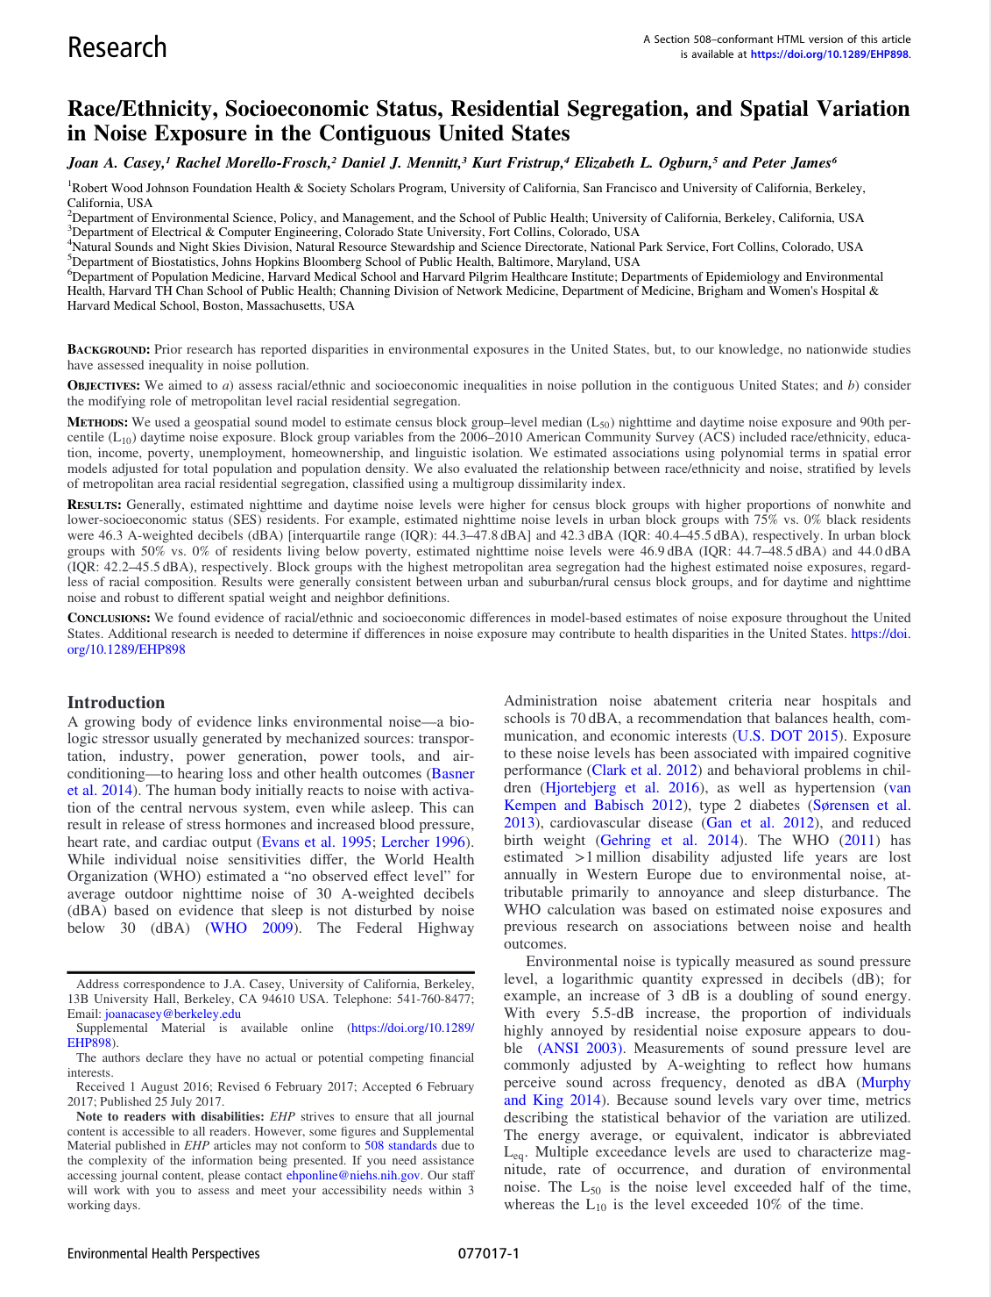
Disparities in Noise Exposure
Casey et al. (2017)
Looked at noise level exposure amongst SES of race, income, education level and within segregated communities
Dale et al. (2015) and Huang et al. (2021)
Found that income is also a determining factor of noise exposure

Slide 10
Population Demographic – Parents (n=23)
Notes:
- Important to note that we had both English speaking and Spanish speaking participants within the study, I mention this because while this chart represents the whole sample population the metrics between these two sub groups were substantial
- The majority of the Spanish speaking population received less than a high school education, made a household income of 15,000 to 30,000

Slide 11
Population Demographics – Children (n = 23)
Notes:
- Given that noise monitoring ran concurrently with the noise monitoring households that had to presence of smoking/vaping indoors were ideal participants
However there were two separate incidents of these behaviors happening ( list participants ID and Locations) → be interesting to see how this affects the data for air sampling
Most children in the study were Latino and between the ages of 11 – 13
In terms of gender, a slight skew of female with there being less males

Slide 12
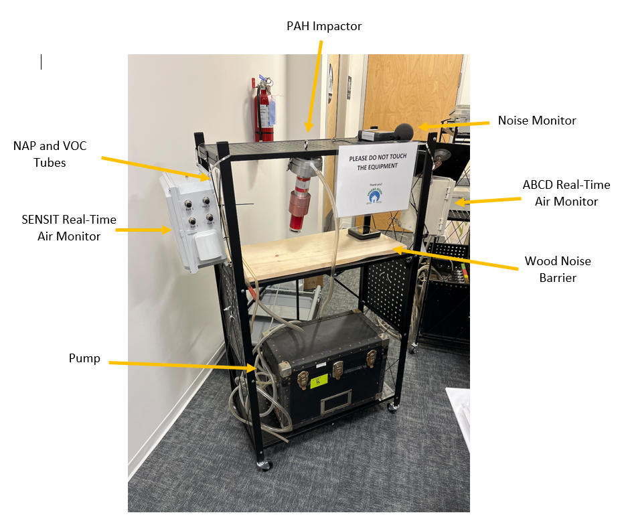
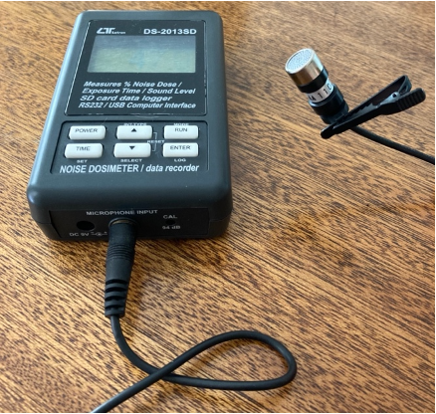
Data Collection and Methods

Slide 13
Cross reference data Sets with Monitoring Dates
Data Cleaning and Quality Checks
Check for duplicate data sets spanning across multiple days
Ensuring data is viable and in preparation of data analysis
Keep track of error occurrence and percentages

Slide 14


Summary Statistics
Indoor ( n=11)
Personal (n=5)
Outdoor (n=6)
Average
61.3
52.3
59.1
Standard Deviation
6.3
9.2
2.8
Median
60.3
50.4
59.3
Range
39.1, 93.7
33.9, 91.3
41.1, 93.6

Slide 15
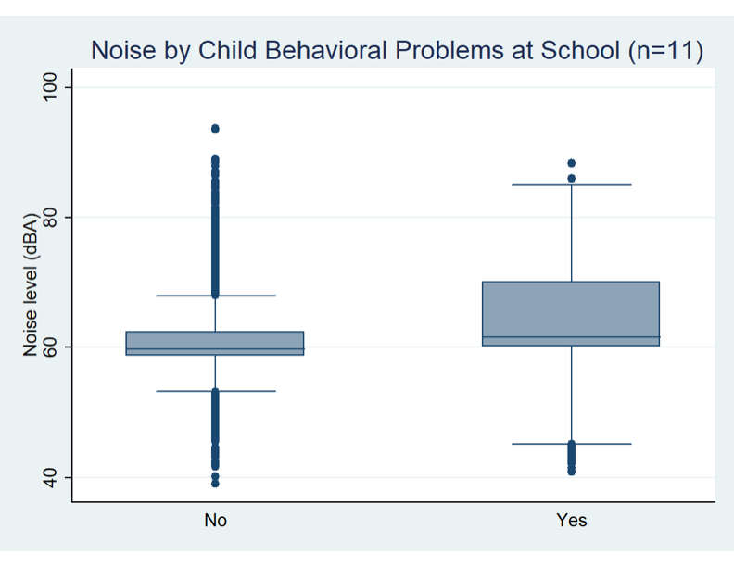
Variable of Interest – Child Behavior

Slide 16
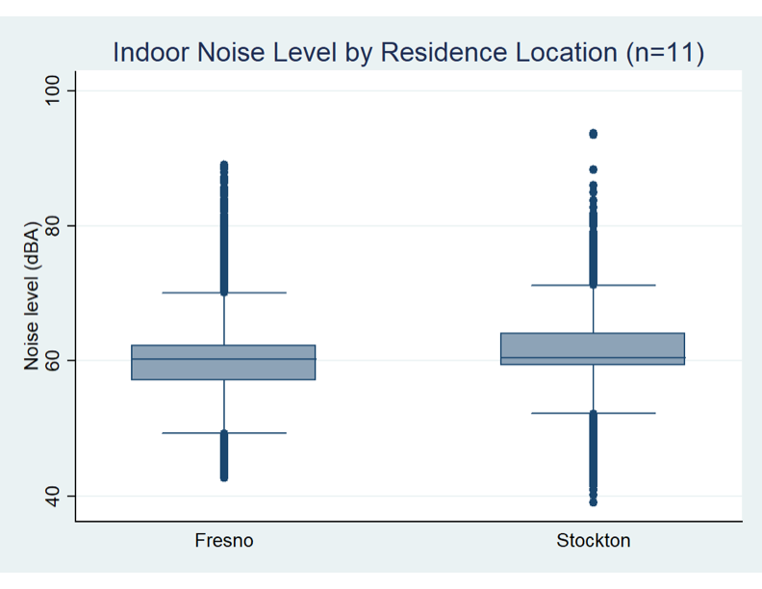
Variable of Interest – Location

Slide 17

Limitations
Outdoor and Indoor Sampling may not be truly representative of ambient noise levels
Participant error of equipment leaves some room for misreporting to happen
Current data analysis is working within a small sample size with little variability within SES factors
Future
Continue collecting noise monitoring samples in Fresno and Stockton region to expand sample size
Geo-code houses via GIS to access nearby sources of expsoure
LIMITATIONS AND FUTURE OBJECTIVES OF SPHERE

Slide 18







Thank you!
STEER Cohort, Sadie Costello, Carissa Harris
Jesus Alfraro, Norma Firestone, Gina Grayson

